Slide 1

Infra as Code using ARM Templates, Deployment Scripts & TemplateSpecs
Jorge Cotillo
Senior Software Engineer
Microsoft Azure – ARM Deployments Team

Slide 2
Agenda
What is an ARM Template?
IaC a declarative approach
What is Deployment Scripts?
Deployment Scripts – Powershell demo
Deployment Scripts – Bash demo
Deployment Scripts considerations
Deployment Scripts – Meet compliance regulations
Monolithic vs Modularized Templates
Share and modularize your Templates – TemplateSpecs
Q&A

Slide 3
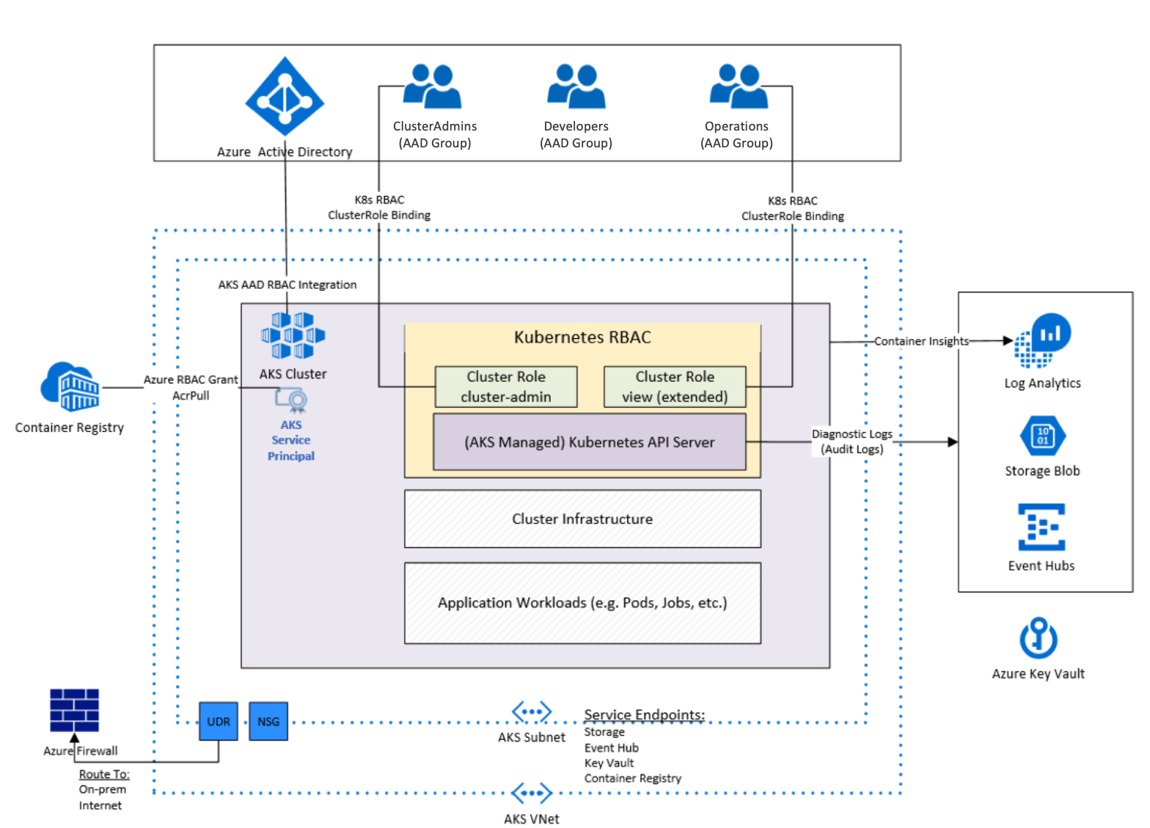


What is an ARM Template?
Building blocks to create an environment
Notes:
Resource group as a logical grouping to manage access
Create Networking resources and manage access to certain team or team members
A single resource by itself not super useful

Slide 4
ARM Template || Azure CLI || Azure Powershell || Terraform
All acceptable approaches
Depends on Team knowledge
Be aware of Pros and Cons
 | ARM Template | Azure CLI | Azure Powershell | Terraform
Gets new Resource Providers (RPs) | Yes | No | No | No
Single API Call to provision resources | Yes | No | No | No
Learning curve | Medium | Easy | Easy | Medium
Multi-cloud | Sort of | No | No | No
Notes:
Which tool gets to deploy new RPs first?
All RPs goes through ARM so usually their PUT operations are supported as part of an ARM template
CLI and Powershell -> Swagger – SDK – Tooling
Swagger is a contract
CLI and Powershell works with commands
Limit on PUT calls – unlikely to hit
Multi-cloud – Azure Arc

Slide 5
IaC a declarative approach
Declare the state of a resource
What you see is what you get
Like HTML, you know what components you will get but you don’t know how they’ll look
Notes:
* For example CSS to style your HTML

Slide 6
Is a declarative approach sufficient to provision resources?
AKS Example …
If(), copy(), …
Notes:
To provision an AKS environment
What about when you start adding functions()? Not too declarative anymore
Functions moves toward imperative approach

Slide 7


What is Deployment Scripts?
Declarative approach is not sufficient
Resource deployment to finalize an environment configuration (e.g. Azure AD graph API – create KeyVault keys, create users, associate K8S RBAC to Azure AD RBAC, etc.)
Notes:
To access control and data plane operations not available through ARM templates
Usually POST operations

Slide 8


How Deployment Scripts works?
Creates two supporting resources in Customer’s subscription:
Azure Storage Account – LRS, Standard SKU, Https enabled
Azure Container Instance – Mounts Storage Account as a volume
Notes:
Creates supporting resources
Locally Redundant - LRS
Compliance purposes (think about Azure DevOps and self-hosted agents)
Don’t want your scripts executed in a Microsoft managed tenant
ACI runs your script
The storage account hosts your scripts

Slide 9

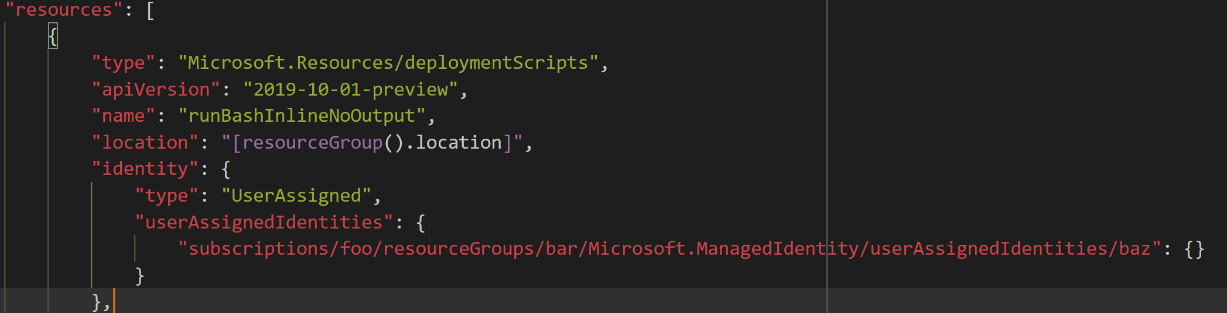
What about the permissions to create the supporting resources?
Deployment Scripts uses its defined User Managed Identity
Notes:
* User managed identity is the one creating ACI and the storage account

Slide 10

Deployment Scripts using Powershell demo
Azure_pwsh_executes_inline_script_no_outputs_deploy.json
Azure_pwsh_executes_inline_script_with_outputs_deploy.json

Slide 11
Deployment Scripts using Bash demo
Azure_cli_executes_inline_throws_error_deploy.json
Azure_cli_executes_inline _with_outputs_deploy.json
Azure_cli_executes_python_deploy.json

Slide 12
Deployment Scripts considerations
Bootstrap script (Powershell and Bash)
CleanupPreference
OnSuccess, OnExpiration, Always
Escaping arguments
ACI expects a command as a string array
We follow this escaping model: https://docs.microsoft.com/en-us/windows/win32/api/shellapi/nf-shellapi-commandlinetoargvw#remarks
Use this to double escape: https://www.jsonescaper.com/
Timeout
ForceUpdateTag to force a script update
Job timeout (1 hour)
Notes:
Bootstrap orchestrates your script execution
Script fails, container in running state for 1 hour (debug)
CleanupPreference -> deletes supporting resources
OnSuccess and script fails -> keeps supporting resources
OnExpiration -> deletes supporting resources after some period of time
System call
Escaping -> C# escapes your string, we need double escaping
ForceUpdateTag -> Using supporting script, no way for the RP to detect a change, results in no-op (no operation)
DeploymentScripts to provision an entire Azure environment

Slide 13
Deployment Scripts – Meet compliance regulations
Use existing storage account
Use custom ACI name
Notes:
Use your own storage account -> Policy enforcing naming convention
Custom ACI name -> Policy enforcing naming convention
Delete file shares
ACI name -> race condition
We wait for a script

Slide 14
Deployment Scripts – Meet compliance regulations - WIP
Service endpoint
Token forwarding (OBO)
Notes:
ACI service endpoint in the works
Support with managed identities
OBO, use logged in user credentials to create supporting resources
Managed identity of DeploymentScripts scoped to what it needs to do

Slide 15
Monolithic vs Modularized Templates
AKS Example …
Linked templates
Linked templates challenges
Stage them in a public location
Synchronize them with your SCM
Notes:
AKS in one big template
Divide and conquer
Challenges:
Azure can access template
Replicate template update
Storage Account CDN for global access

Slide 16

Share and modularize your Templates - TemplateSpecs
New way to stage your templates
Is a first-class Azure Resource
You can apply Azure Policy, RBAC
Reside in a Resource Group
Replaces Azure Blueprint definitions
CLI for now
Soon will be in Azure Powershell and Azure CLI

Slide 17
TemplateSpecs Demo
Upload deployment script
Deploy deployment script

Slide 18
Q&A

Slide 19
References
Azure rest-api: https://github.com/Azure/azure-rest-api-specs
Signup for TemplateSpecs – Private preview: https://aka.ms/templateSpecOnboarding
Deployment Scripts doc - https://docs.microsoft.com/en-us/azure/azure-resource-manager/templates/deployment-script-template
Template Specs quickstart repo: https://github.com/Azure/template-specs
Github repo: https://github.com/jorgecotillo/boston_azure_2020
Email: jcotillo@microsoft.com

